Slide 1

DATA STRUCTURES & Vısualızatıon Alican CÖMERT

Slide 2
DATA STRUCTUREs

Slide 3
Bits & Bytes
Bits
The smallest unit of information in a computer
0 or 1
“Bits” are often used in terms of a data rate, or speed of information flow:
Bytes
8 bits
“Bytes” are often used in terms of storage or capacity--computer memories are organized in terms of 8 bits
Eg. 0100 1010₂ = 4A₁₆ = 74 = ‘J’
32-bit sound card
64-bit video accelerator card
128-bit encryption in your browser
8
4
2
1
8
4
2
1
0100 1010
4
A
= 4A
3
ManP/CTG | 2018-04-20
© Robert Bosch GmbH 2018. All rights reserved, also regarding any disposal, exploitation, reproduction, editing, distribution, as well as in the event of applications for industrial property rights.

Slide 4
Communication between machines and human
Represent text in binary form
ASCII is an acronym for American Standard Code for Information Interchange
Its structure is a 7 bit code (plus a parity bit or an “extended” bit in some implementations
ASCII can represent 128 symbols (2⁷ symbols)
4
ManP/CTG | 2018-04-20
© Robert Bosch GmbH 2018. All rights reserved, also regarding any disposal, exploitation, reproduction, editing, distribution, as well as in the event of applications for industrial property rights.

Slide 5
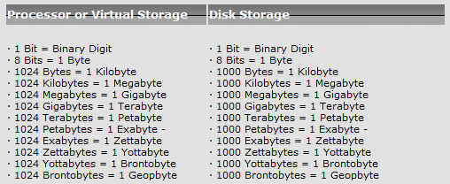
Size Matters
Thousand, Million, Billion, Trillion, Quadrillion, Quintillian, Hexillion, Heptillion

Slide 6
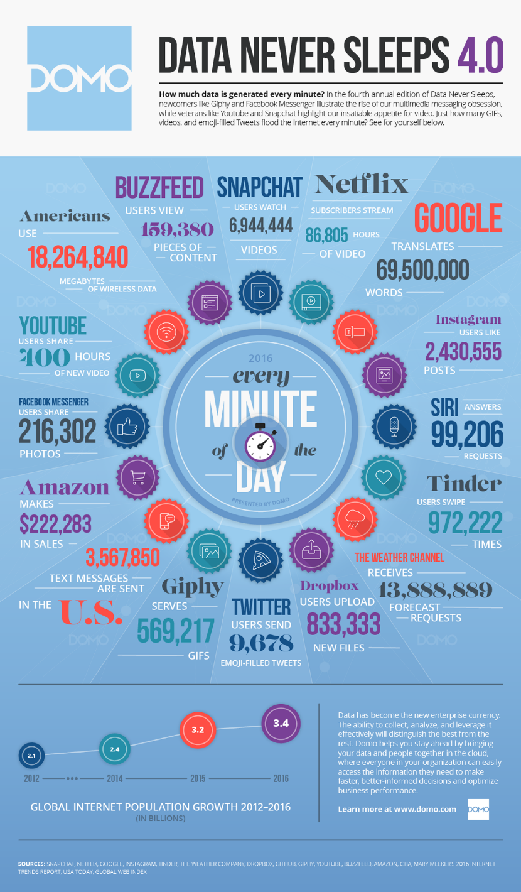
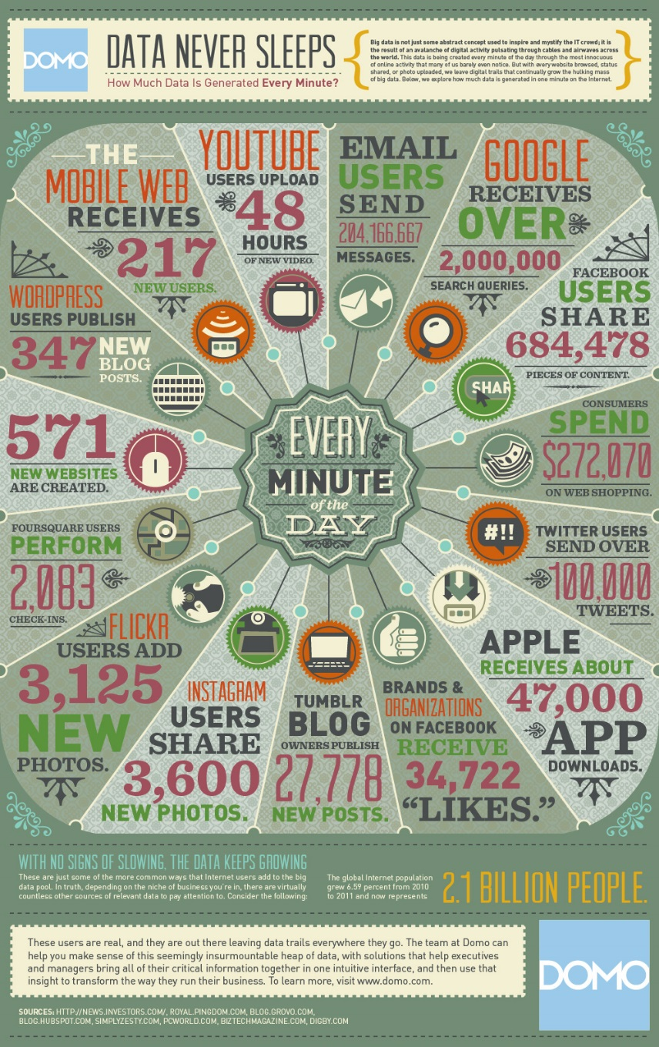
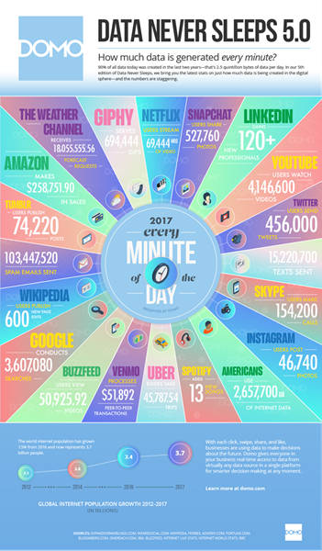
Header of section
6
ManP/CTG | 2018-04-20
© Robert Bosch GmbH 2018. All rights reserved, also regarding any disposal, exploitation, reproduction, editing, distribution, as well as in the event of applications for industrial property rights.

Slide 7
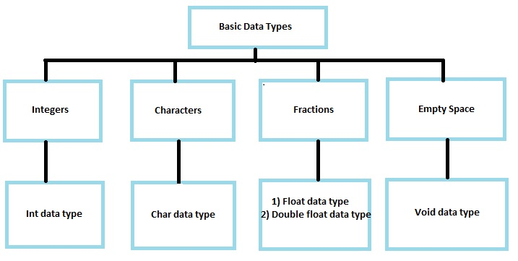
Basic Data Types
7
ManP/CTG | 2018-04-20
© Robert Bosch GmbH 2018. All rights reserved, also regarding any disposal, exploitation, reproduction, editing, distribution, as well as in the event of applications for industrial property rights.

Slide 8
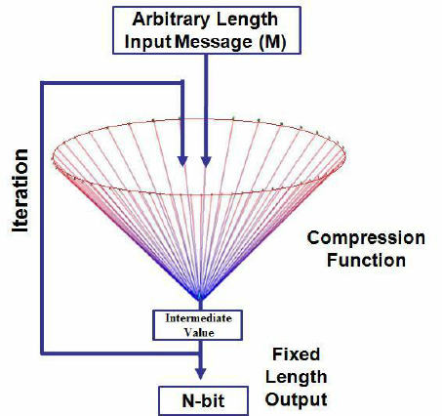
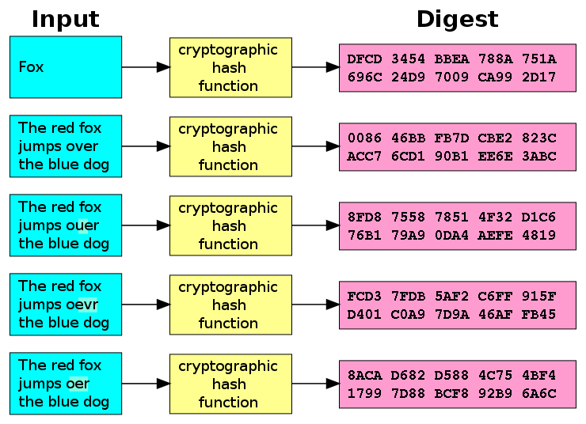
Hash Functions
8
ManP/CTG | 2018-04-20
© Robert Bosch GmbH 2018. All rights reserved, also regarding any disposal, exploitation, reproduction, editing, distribution, as well as in the event of applications for industrial property rights.

Slide 9
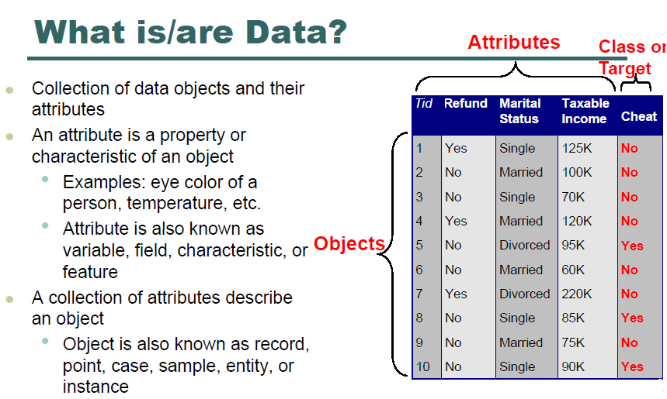
Objects
9
ManP/CTG | 2018-04-20
© Robert Bosch GmbH 2018. All rights reserved, also regarding any disposal, exploitation, reproduction, editing, distribution, as well as in the event of applications for industrial property rights.

Slide 10
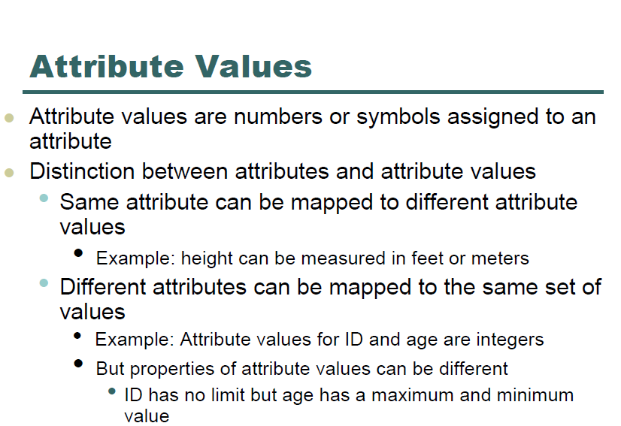
10
ManP/CTG | 2018-04-20
© Robert Bosch GmbH 2018. All rights reserved, also regarding any disposal, exploitation, reproduction, editing, distribution, as well as in the event of applications for industrial property rights.

Slide 11
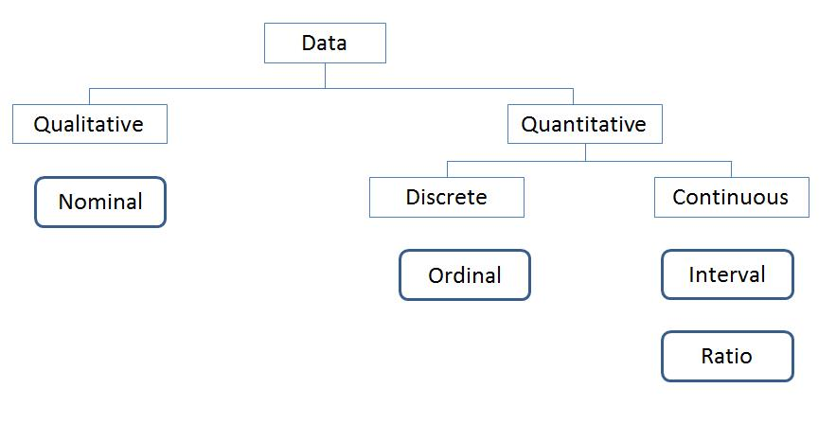
AttributeTypes
11
ManP/CTG | 2018-04-20
© Robert Bosch GmbH 2018. All rights reserved, also regarding any disposal, exploitation, reproduction, editing, distribution, as well as in the event of applications for industrial property rights.

Slide 12
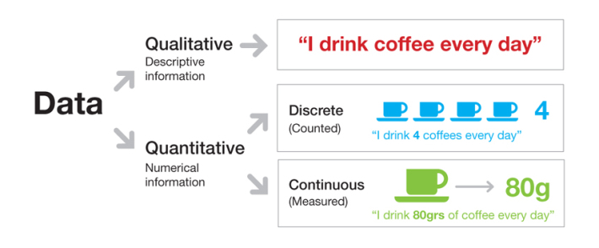
AttributeTypes
12
ManP/CTG | 2018-04-20
© Robert Bosch GmbH 2018. All rights reserved, also regarding any disposal, exploitation, reproduction, editing, distribution, as well as in the event of applications for industrial property rights.

Slide 13
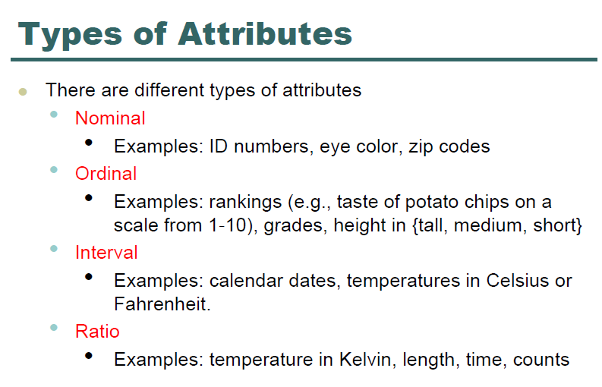
Header of section
13
ManP/CTG | 2018-04-20
© Robert Bosch GmbH 2018. All rights reserved, also regarding any disposal, exploitation, reproduction, editing, distribution, as well as in the event of applications for industrial property rights.

Slide 14
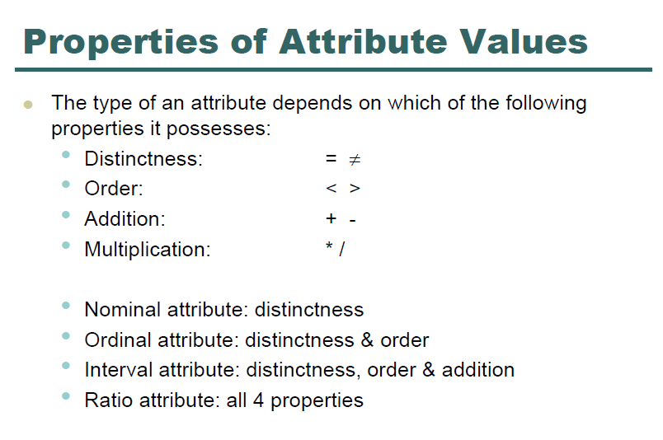
14
ManP/CTG | 2018-04-20
© Robert Bosch GmbH 2018. All rights reserved, also regarding any disposal, exploitation, reproduction, editing, distribution, as well as in the event of applications for industrial property rights.

Slide 15
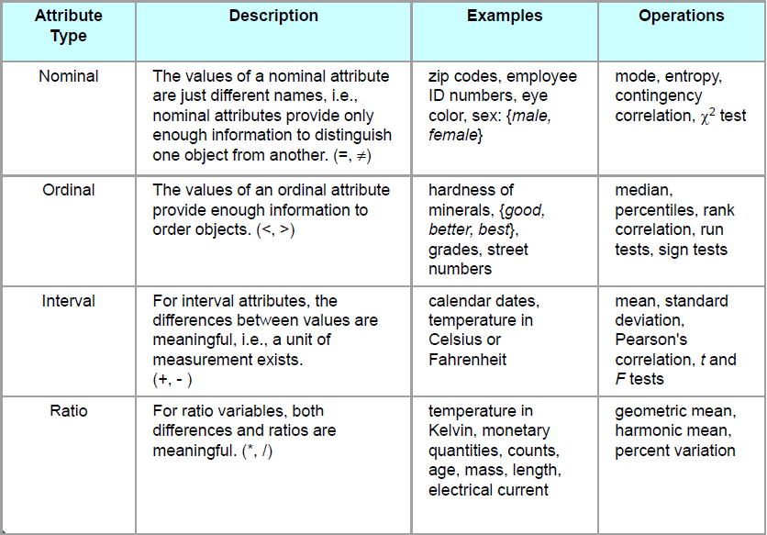
15
ManP/CTG | 2018-04-20
© Robert Bosch GmbH 2018. All rights reserved, also regarding any disposal, exploitation, reproduction, editing, distribution, as well as in the event of applications for industrial property rights.

Slide 16
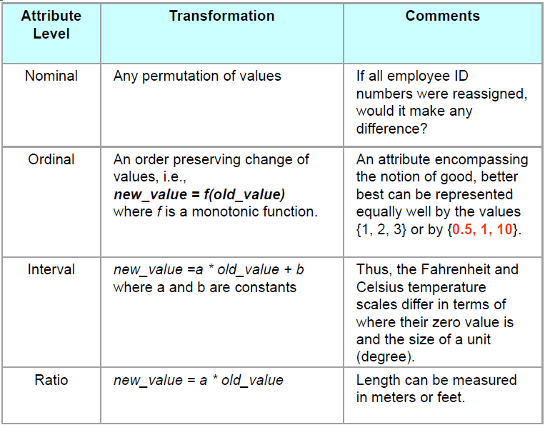
16
ManP/CTG | 2018-04-20
© Robert Bosch GmbH 2018. All rights reserved, also regarding any disposal, exploitation, reproduction, editing, distribution, as well as in the event of applications for industrial property rights.

Slide 17
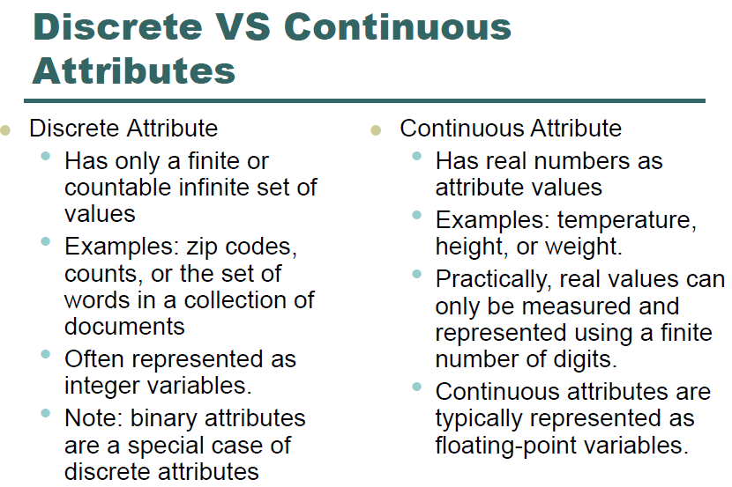
17
ManP/CTG | 2018-04-20
© Robert Bosch GmbH 2018. All rights reserved, also regarding any disposal, exploitation, reproduction, editing, distribution, as well as in the event of applications for industrial property rights.

Slide 18
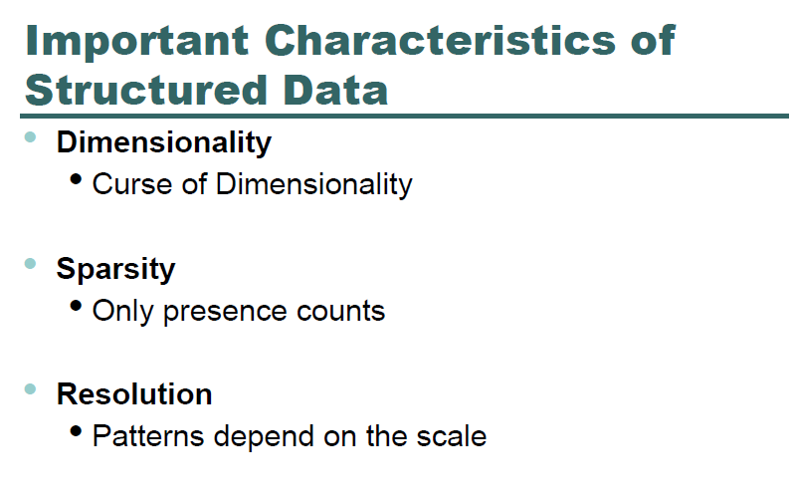
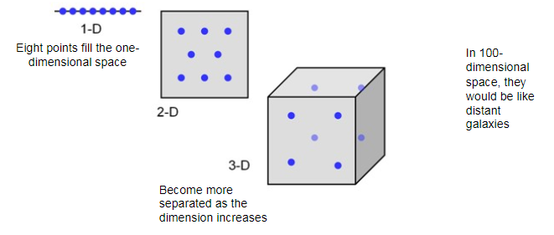
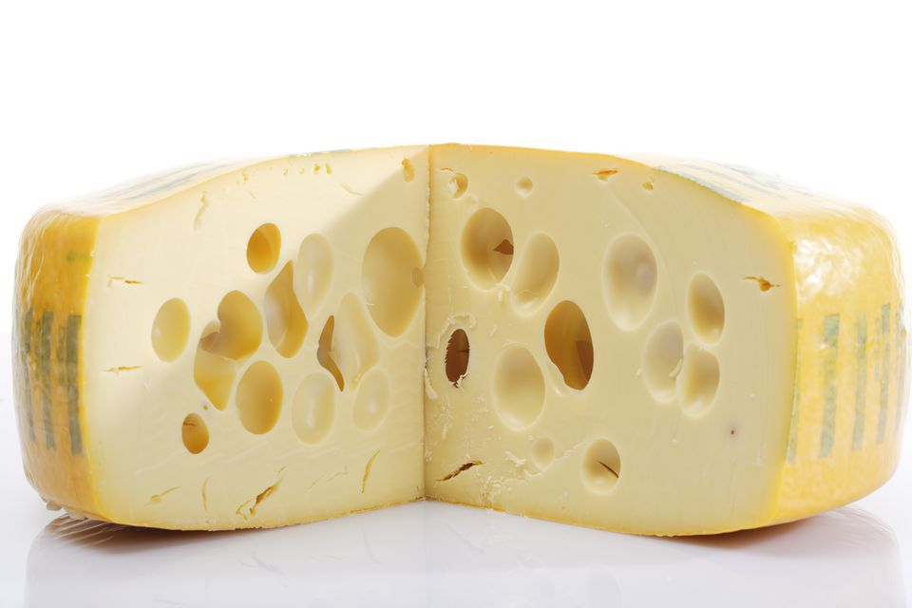

18
ManP/CTG | 2018-04-20
© Robert Bosch GmbH 2018. All rights reserved, also regarding any disposal, exploitation, reproduction, editing, distribution, as well as in the event of applications for industrial property rights.

Slide 19
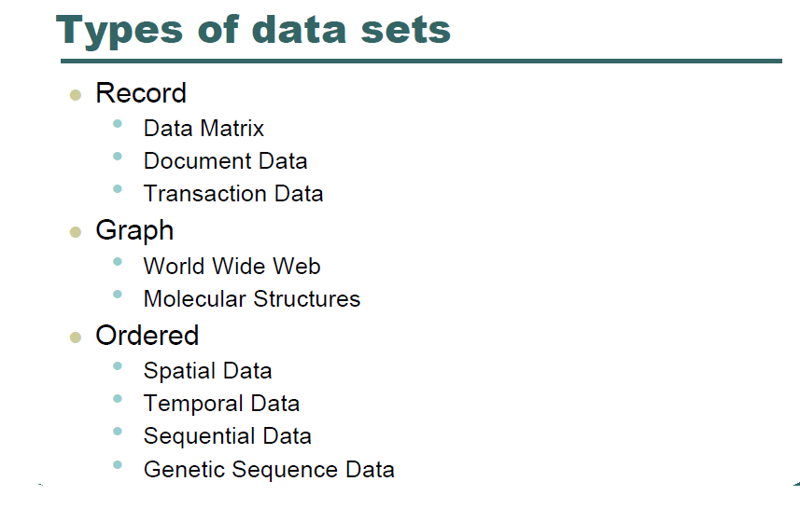
19
ManP/CTG | 2018-04-20
© Robert Bosch GmbH 2018. All rights reserved, also regarding any disposal, exploitation, reproduction, editing, distribution, as well as in the event of applications for industrial property rights.

Slide 20
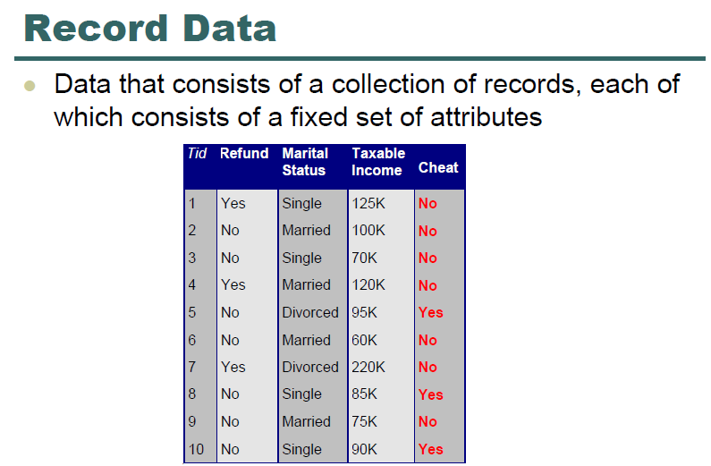
20
ManP/CTG | 2018-04-20
© Robert Bosch GmbH 2018. All rights reserved, also regarding any disposal, exploitation, reproduction, editing, distribution, as well as in the event of applications for industrial property rights.

Slide 21
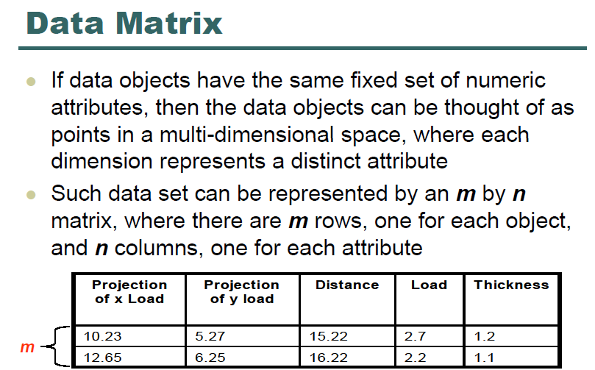
21
ManP/CTG | 2018-04-20
© Robert Bosch GmbH 2018. All rights reserved, also regarding any disposal, exploitation, reproduction, editing, distribution, as well as in the event of applications for industrial property rights.

Slide 22
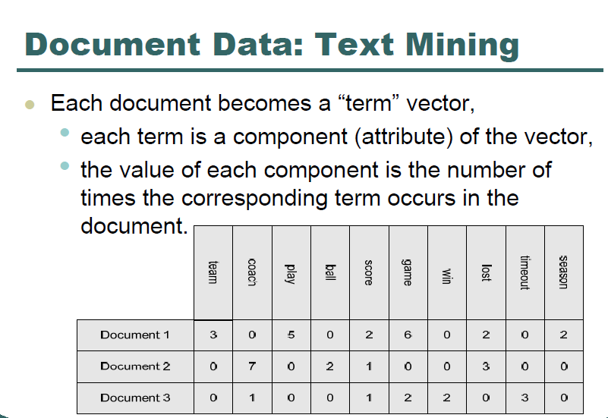
22
ManP/CTG | 2018-04-20
© Robert Bosch GmbH 2018. All rights reserved, also regarding any disposal, exploitation, reproduction, editing, distribution, as well as in the event of applications for industrial property rights.

Slide 23
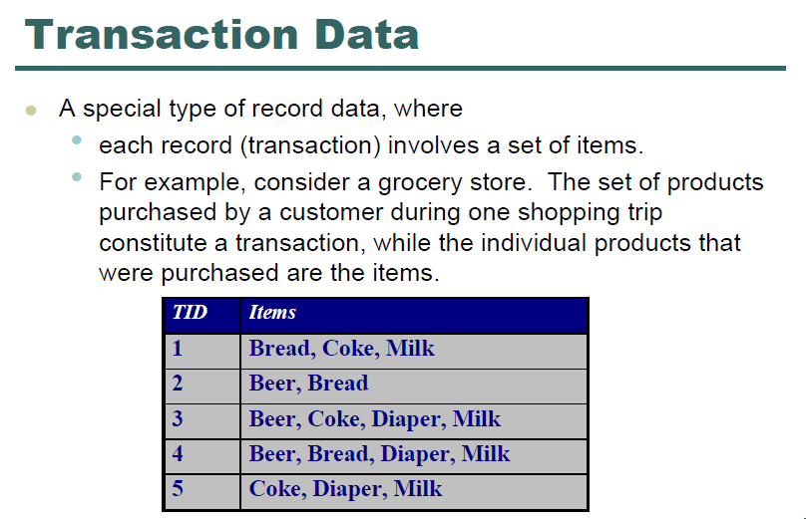
23
ManP/CTG | 2018-04-20
© Robert Bosch GmbH 2018. All rights reserved, also regarding any disposal, exploitation, reproduction, editing, distribution, as well as in the event of applications for industrial property rights.

Slide 24
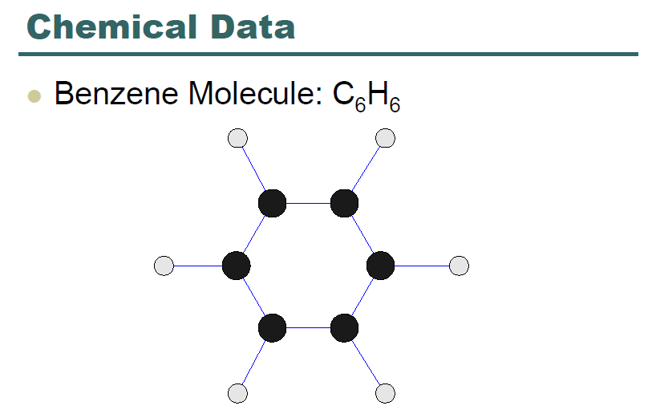
24
ManP/CTG | 2018-04-20
© Robert Bosch GmbH 2018. All rights reserved, also regarding any disposal, exploitation, reproduction, editing, distribution, as well as in the event of applications for industrial property rights.

Slide 25
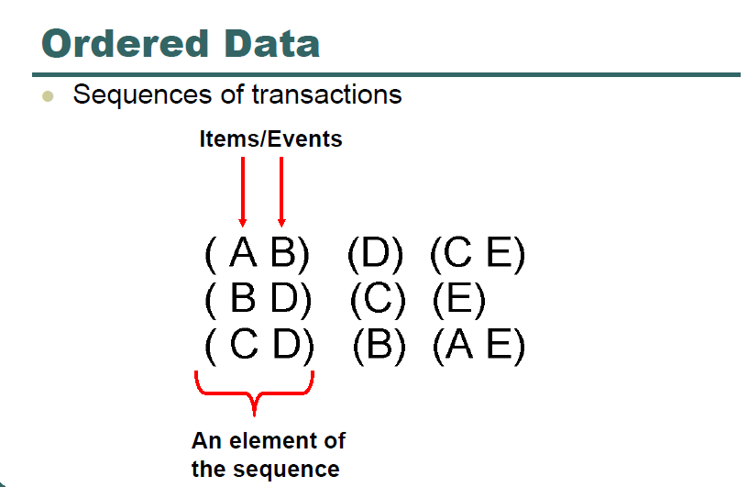
25
ManP/CTG | 2018-04-20
© Robert Bosch GmbH 2018. All rights reserved, also regarding any disposal, exploitation, reproduction, editing, distribution, as well as in the event of applications for industrial property rights.

Slide 26
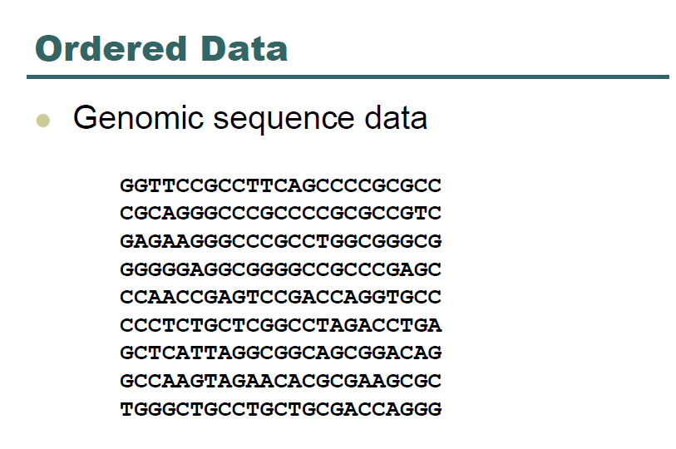
26
ManP/CTG | 2018-04-20
© Robert Bosch GmbH 2018. All rights reserved, also regarding any disposal, exploitation, reproduction, editing, distribution, as well as in the event of applications for industrial property rights.

Slide 27
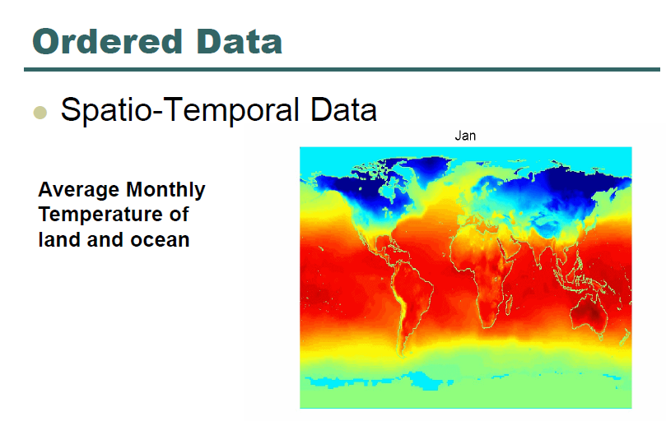
27
ManP/CTG | 2018-04-20
© Robert Bosch GmbH 2018. All rights reserved, also regarding any disposal, exploitation, reproduction, editing, distribution, as well as in the event of applications for industrial property rights.

Slide 28
Data vısualızatıon

Slide 29
Types of Data Visualization
Scientific Visualization
Structural Data – Seismic, Medical, ..
Information Visualization
No inherent structure – News, stock market, top grossing movies, facebook connections
Visual Analytics
Use visualization to understand and synthesize large amounts of multimodal data – audio, video, text, images, networks of people ..
29
ManP/CTG | 2018-04-20
© Robert Bosch GmbH 2018. All rights reserved, also regarding any disposal, exploitation, reproduction, editing, distribution, as well as in the event of applications for industrial property rights.

Slide 30
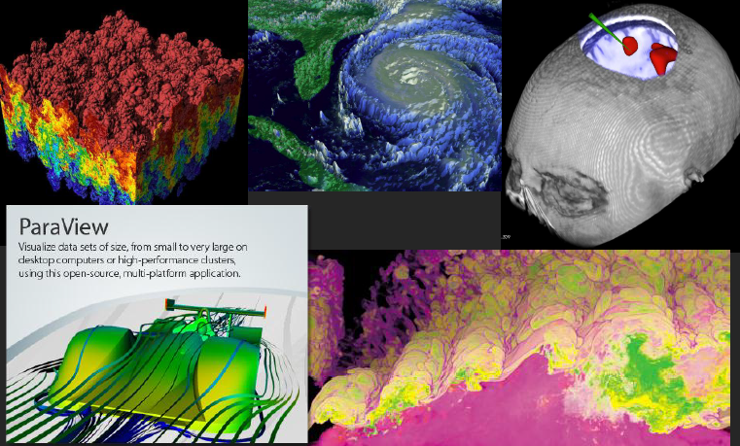
Scientific Visualization
30
ManP/CTG | 2018-04-20
© Robert Bosch GmbH 2018. All rights reserved, also regarding any disposal, exploitation, reproduction, editing, distribution, as well as in the event of applications for industrial property rights.

Slide 31
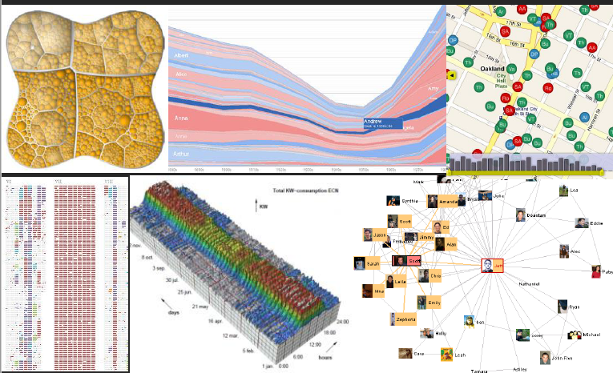
Information Visualization
31
ManP/CTG | 2018-04-20
© Robert Bosch GmbH 2018. All rights reserved, also regarding any disposal, exploitation, reproduction, editing, distribution, as well as in the event of applications for industrial property rights.

Slide 32
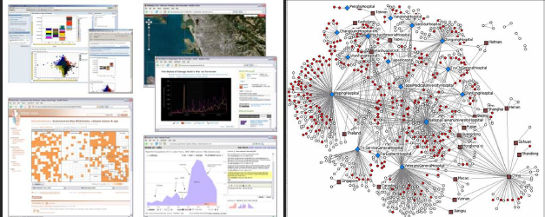
Visual Analytics
32
ManP/CTG | 2018-04-20
© Robert Bosch GmbH 2018. All rights reserved, also regarding any disposal, exploitation, reproduction, editing, distribution, as well as in the event of applications for industrial property rights.

Slide 33
Four questions
DATA VISUALIZATION
1. What data is important to show?
2. What do I want to emphasize in the data?
3. What options do I have for displaying this data?
4. Which option is most effective in communicating the data?
33
ManP/CTG | 2018-04-20
© Robert Bosch GmbH 2018. All rights reserved, also regarding any disposal, exploitation, reproduction, editing, distribution, as well as in the event of applications for industrial property rights.

Slide 34
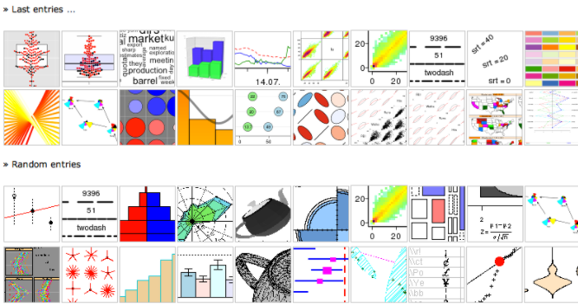
Header of section
34
ManP/CTG | 2018-04-20
© Robert Bosch GmbH 2018. All rights reserved, also regarding any disposal, exploitation, reproduction, editing, distribution, as well as in the event of applications for industrial property rights.

Slide 35
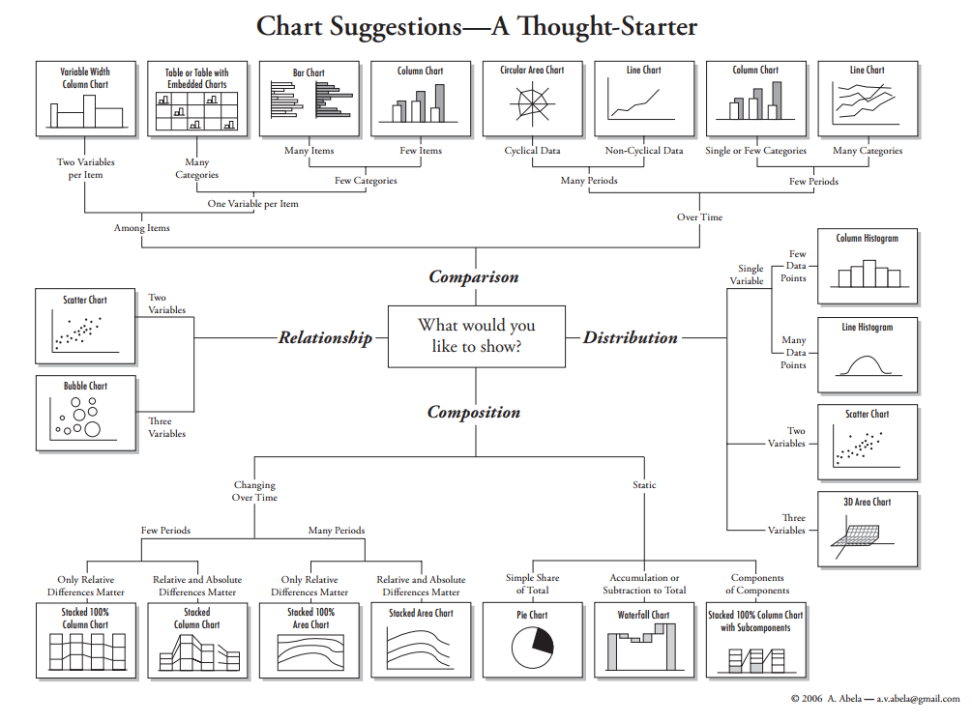
35
ManP/CTG | 2018-04-20
© Robert Bosch GmbH 2018. All rights reserved, also regarding any disposal, exploitation, reproduction, editing, distribution, as well as in the event of applications for industrial property rights.

Slide 36
What do you want to show with your data?
Header of section
Time Series
Ranking
Part-To-Whole
Deviation
Distribution
Correlation
Comparison
36
ManP/CTG | 2018-04-20
© Robert Bosch GmbH 2018. All rights reserved, also regarding any disposal, exploitation, reproduction, editing, distribution, as well as in the event of applications for industrial property rights.

Slide 37
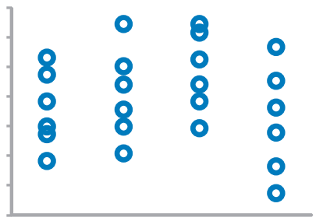
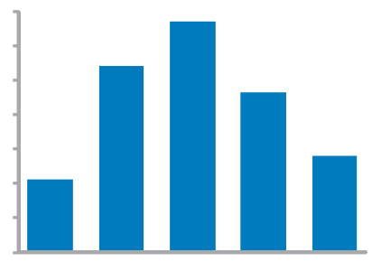
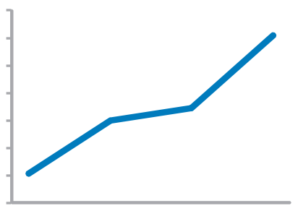
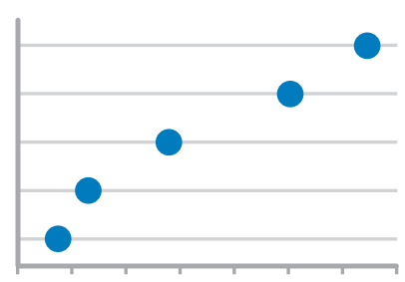
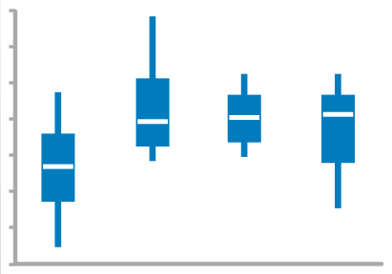
Values display how something changed over time
Time series
Strip Plot (multiple)
Only when also featuring distributions
Bar Graph (vertical)
To feature individual values and support their comparisons. Quantitative scale must begin at zero.
Line Graph
To feature overall trends and patterns and support their comparisons
Dot Plot (vertical)
When you do not have a value for every interval of time
37
ManP/CTG | 2018-04-20
Box Plot (vertical)
© Robert Bosch GmbH 2018. All rights reserved, also regarding any disposal, exploitation, reproduction, editing, distribution, as well as in the event of applications for industrial property rights.

Slide 38
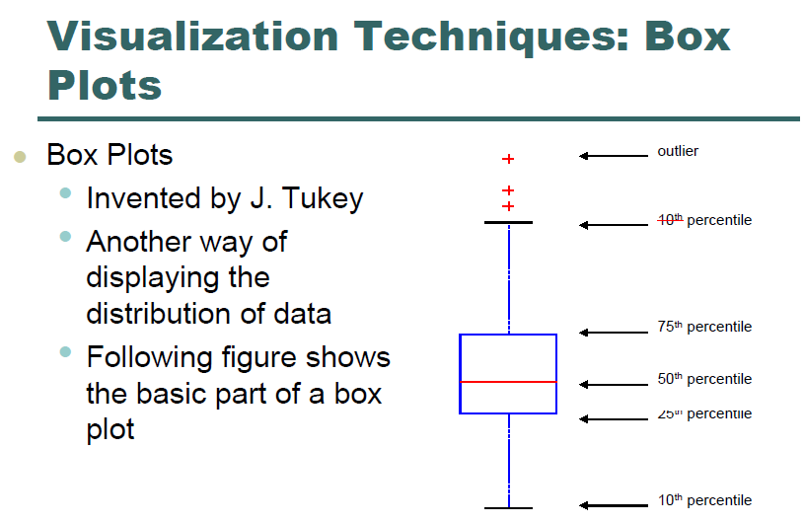
38
ManP/CTG | 2018-04-20
© Robert Bosch GmbH 2018. All rights reserved, also regarding any disposal, exploitation, reproduction, editing, distribution, as well as in the event of applications for industrial property rights.

Slide 39
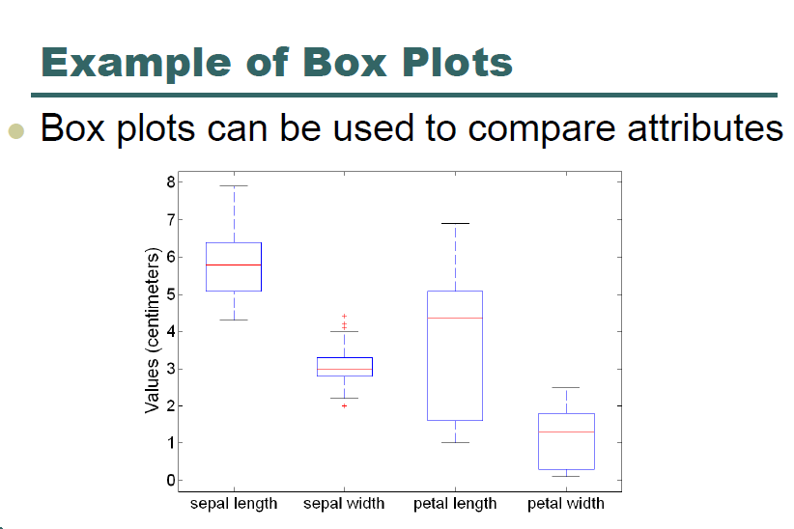
39
ManP/CTG | 2018-04-20
© Robert Bosch GmbH 2018. All rights reserved, also regarding any disposal, exploitation, reproduction, editing, distribution, as well as in the event of applications for industrial property rights.

Slide 40
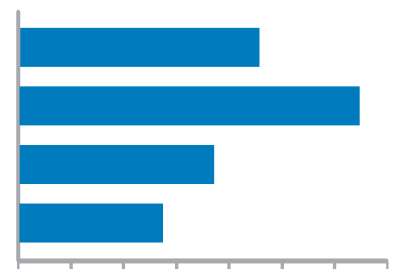
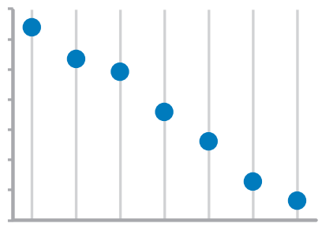
Values are ordered by size (descending or ascending)
Ranking
Bar Graphs
Quantitative scale must begin at zero
Dot Plots
40
ManP/CTG | 2018-04-20
© Robert Bosch GmbH 2018. All rights reserved, also regarding any disposal, exploitation, reproduction, editing, distribution, as well as in the event of applications for industrial property rights.

Slide 41
Values represent parts (ratios) of a whole
Part-to-whole
Bar Graphs
Quantitative scale must begin at zero
41
ManP/CTG | 2018-04-20
© Robert Bosch GmbH 2018. All rights reserved, also regarding any disposal, exploitation, reproduction, editing, distribution, as well as in the event of applications for industrial property rights.

Slide 42
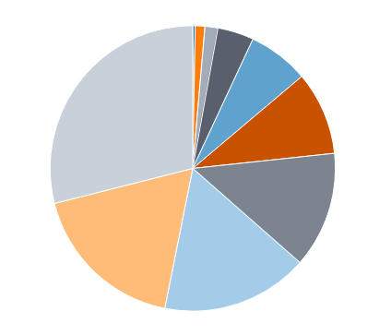
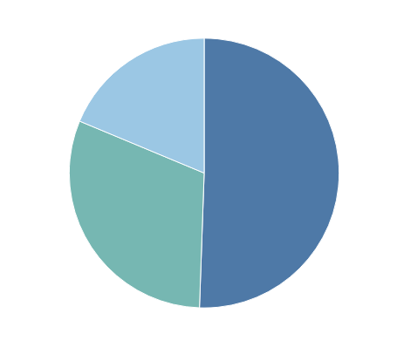
What about pie charts?
Commonly used to show parts of a whole
However…
Hard to judge relative size of pie slices – better at differentiating length
Take up a lot of space to present little information
Require labels and good color contrast to even be usable (often difficult)
Best use is when one overwhelmingly larger value than the rest – no need to focus on actual values
42
ManP/CTG | 2018-04-20
© Robert Bosch GmbH 2018. All rights reserved, also regarding any disposal, exploitation, reproduction, editing, distribution, as well as in the event of applications for industrial property rights.

Slide 43
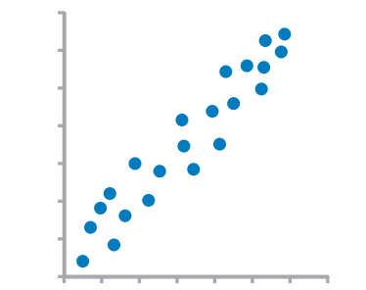
Comparison of two paired sets of values to determine if there is a relationship between them
Correlation
Scatter Plot
43
ManP/CTG | 2018-04-20
© Robert Bosch GmbH 2018. All rights reserved, also regarding any disposal, exploitation, reproduction, editing, distribution, as well as in the event of applications for industrial property rights.

Slide 44
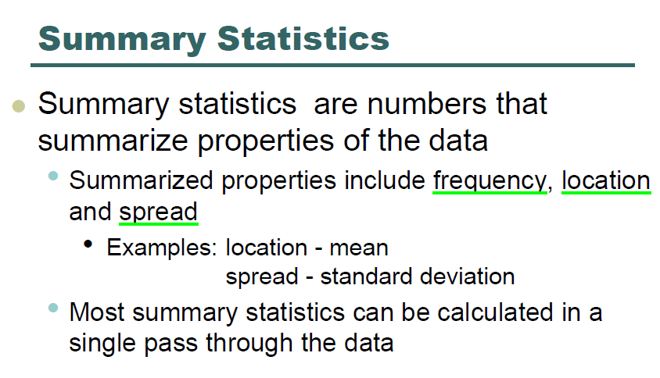
44
ManP/CTG | 2018-04-20
© Robert Bosch GmbH 2018. All rights reserved, also regarding any disposal, exploitation, reproduction, editing, distribution, as well as in the event of applications for industrial property rights.

Slide 45
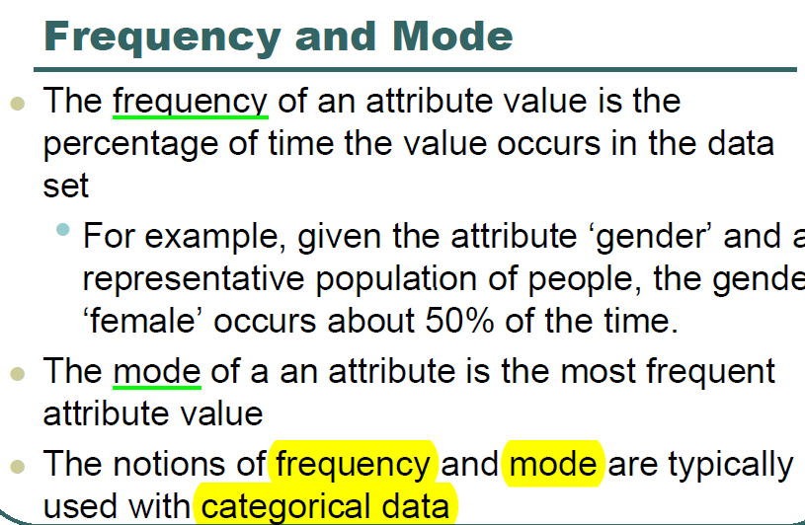
45
ManP/CTG | 2018-04-20
© Robert Bosch GmbH 2018. All rights reserved, also regarding any disposal, exploitation, reproduction, editing, distribution, as well as in the event of applications for industrial property rights.

Slide 46
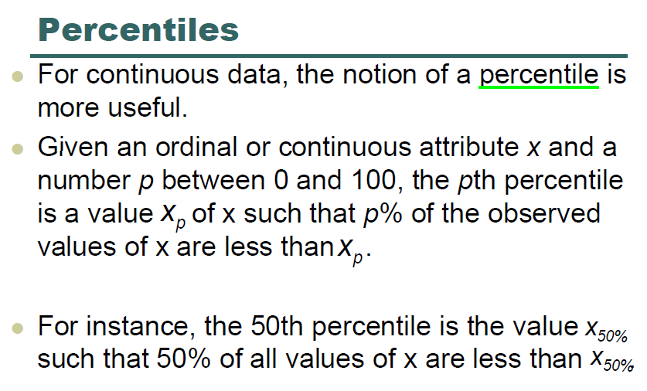
46
ManP/CTG | 2018-04-20
© Robert Bosch GmbH 2018. All rights reserved, also regarding any disposal, exploitation, reproduction, editing, distribution, as well as in the event of applications for industrial property rights.

Slide 47
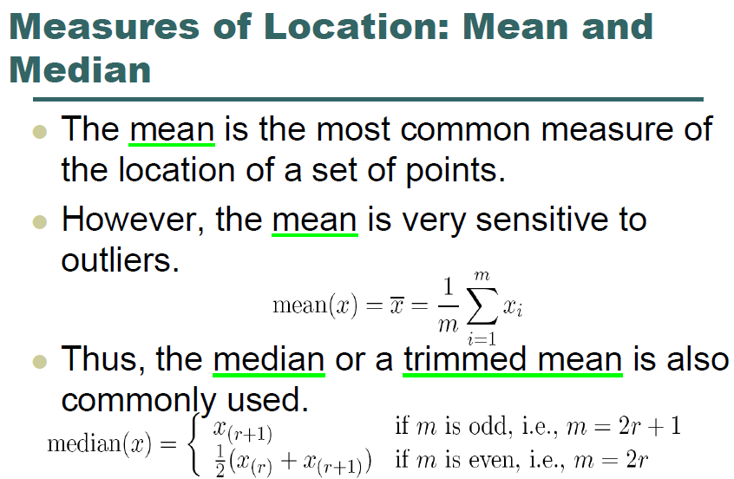
47
ManP/CTG | 2018-04-20
© Robert Bosch GmbH 2018. All rights reserved, also regarding any disposal, exploitation, reproduction, editing, distribution, as well as in the event of applications for industrial property rights.

Slide 48
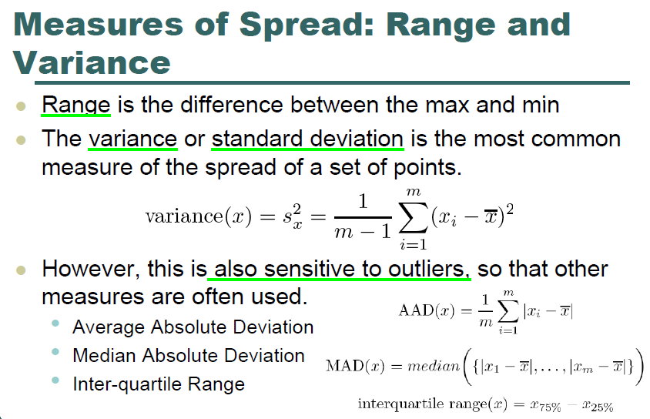
48
ManP/CTG | 2018-04-20
© Robert Bosch GmbH 2018. All rights reserved, also regarding any disposal, exploitation, reproduction, editing, distribution, as well as in the event of applications for industrial property rights.

Slide 49

49
ManP/CTG | 2018-04-20
© Robert Bosch GmbH 2018. All rights reserved, also regarding any disposal, exploitation, reproduction, editing, distribution, as well as in the event of applications for industrial property rights.

Slide 50

50
ManP/CTG | 2018-04-20
© Robert Bosch GmbH 2018. All rights reserved, also regarding any disposal, exploitation, reproduction, editing, distribution, as well as in the event of applications for industrial property rights.

